Slide 1









SINGAPORE
@wwcodesingapore singapore@womenwhocode.com
www.womenwhocode.com/singapore
facebook.com/groups/wwcodesingapore
Notes:
Good Evening and Welcome.
We are Women Who Code.
My name is Yue Lin.
Along with Purnima, Gemeng, Amanda, Yang Ying, Hannah and Marriane.
We are the Leaders of the Singapore Chapter.
And these are our Twitter account. Email contact. Website, and facebook group.
Come tell us how we can help you or what you need. And we will make it happen. Or drop us a message on any of these channels.

Slide 2


OUR MISSION Inspiring women to excel in technology careers.
Notes:
Women Who Code members consist of over 100,000 career-aged tech professionals operating at each level of the industry.
When you become a part of Women Who Code you gain access to programs and services that are designed to help you step up your tech career. You also get the opportunity to communicate and connect with a global community dedicated to supporting you in your professional pursuits.

Slide 3

OUR GOALS
To Provide women with an avenue into tech
To Empower women with the skills they need for professional advancement.
To Build environments where networking and mentorship are valued.
To Create a global community to support women in tech wherever they live.
@wwcodesingapore #wwcode @womenwhocode
Notes:
Our goals:
To Provide women with an avenue into tech
To Empower women with the skills they need for professional advancement.
To Build environments where networking and mentorship are valued.
To Create a global community to support women in tech wherever they live.

Slide 4


“DEAR WOMEN, WE NEED YOU” -The Tech Industry
What we do …
Organise technical events
Code Review (Newsletter)
#ApplaudHer
Scholarships
Conference Tickets
Job board
Notes:
Women Who Code is an international nonprofit that develops programs to help engineers achieve their career goals. Provide learning and leadership opportunities through our growing community of tech professionals.
By providing us a network for support, platform to develop on and tools required to enhance skillsets.

Slide 5

Thank you to our HOST
Notes:
Firstly, we want to say a big thank you to our host, Rakuten.
For providing us the use of this lovely venue, and feeding us tonight.

Slide 6
Data Mining
Yue lin (aryn) choong

Slide 7

Knowledge Discovery from Data (KDD)
DATA MINING
Knowledge Mining
Knowledge Extraction
Knowledge Acquisition
Data / Pattern Analysis
Data Archaeology
Data Dredging
Data Science
Insight Creation
Notes:
What is data mining
https://www.invensis.net/blog/wp-content/uploads/2015/11/12-Data-Mining-Tools-and-Techniques-Invensis.png

Slide 8
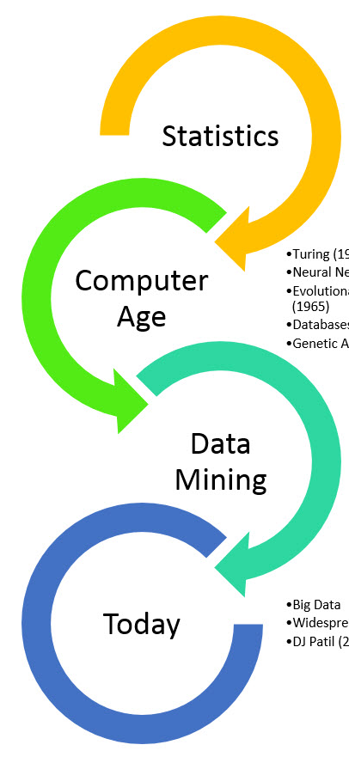
EVOLUTION
DATA MINING
Bayes’ Theorem (1763)
Regression (1805)
Turing (1936)
Neural Networks (1943)
Evolutionary Computation (1965)
Databases (1970s)
Genetic Algorithms (1975)
KDD (1989)
SVM (1992)
Data Science (2001)
Moneyball (2003)
Big Data
Data Warehousing
OLAP (Online Analytical Processing)
Notes:
Online

Slide 9
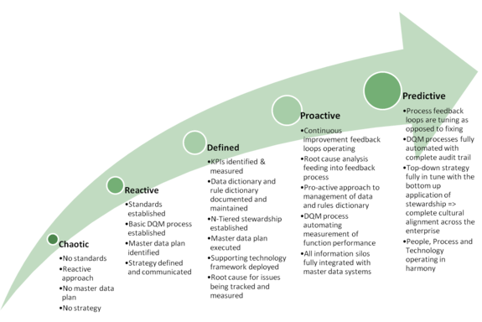
Why Data Mining
Stages of data (business) analytics
Predictive
Proactive
Defined
Reactive
Chaotic
Notes:
Data Rich but Information Poor
http://i0.wp.com/thomsonreutersportia.files.wordpress.com/2012/04/content_dqmm.png

Slide 10
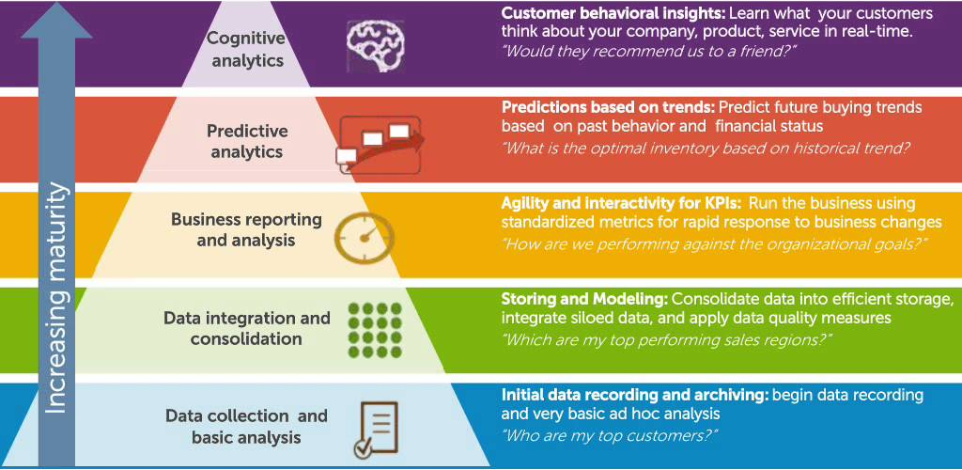
Turn data into Insights
Business data Stages
Notes:
https://i.ytimg.com/vi/C4tdXEdb-zc/maxresdefault.jpg

Slide 11

Types of data
Database Data
Data Warehouses
Transactional Data
Time Sequenced Data
Data Streams
Spacial Data
Images
Meta Data
Notes:
DBMS, relational database, tables, columns, rows, tuples
Multidimensional, Clean-Integrate-Transform-Load-Refresh, Dtat Cube
Items, Customer purchase transaction
Historical records, stock exchange, biological sequence data
Video surveillance, sensor data
Maps
Videos, Images
Tagging, Meta Data
https://static.wixstatic.com/media/53defd_17c4b53bdda34dd89eed13867b9cc1aa~mv2.jpg

Slide 12

Types of patterns / insights
Characterisation
Patterns
Associations / Correlations
Classification (Predictive)
Regression (Predictive)
Cluster Analysis
Outlier
Notes:
Characterisation & Discrimination
https://www.sas.com/en_us/insights/articles/data-management/sensing-a-disturbance-in-the-data/_jcr_content/socialShareImage.img.png

Slide 13

Are all patterns interesting ?
Easily understood by humans
Valid on new or test data with degree of certainty
Potentially useful
Novel
Validates a hypothesis
KNOWLEDGE!
Notes:
https://d3njjcbhbojbot.cloudfront.net/api/utilities/v1/imageproxy/https://coursera-course-photos.s3.amazonaws.com/68/b9ef00533711e4a6d07f1474e53fff/Data_Mining_1.jpg

Slide 14

HOW
Statistics
Machine Learning
Supervised
Unsupervised
Semi-supervised
Active learning
Database System Research
Information Retrieval
Notes:
Collection, analysis, interpretation & presentation. Inferential statistics, hypothesis testing.
Training dataset with labeled examples
Unlabelled input data. e.g. specify the number of clusters
Labelled and unlabelled. e.g. positive and negative examples to define decision boundary
User interfaced labelling with constraints
DB creation, maintenance and use of database. E.g. data model principles, query languages, processing and optimisation methods, data storage and indexing and accessing methods.
Searching for documents, information in documents. E.g. language model, topic modelling
https://www.wellthie.com/wp-content/uploads/2017/05/Screen-Shot-2017-05-23-at-12.01.32-PM.png

Slide 15
Data Mining methodology

Slide 16
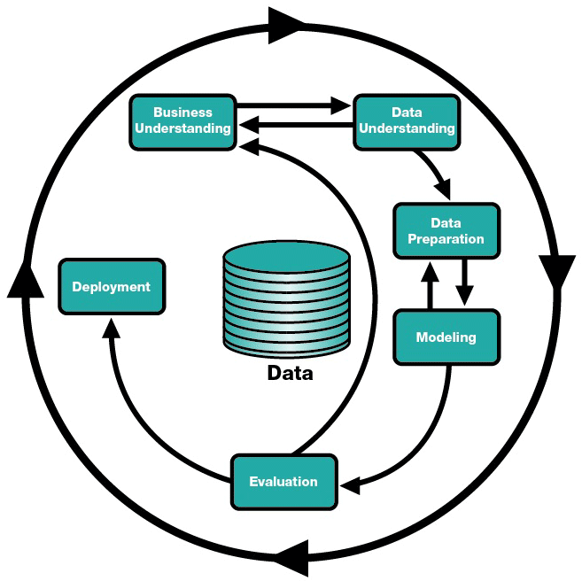
CRISP DM
Cross Industry Standard Process
Loose process
Moving between phases is required
Continuous after deployed
Cyclic nature of data mining

Slide 17
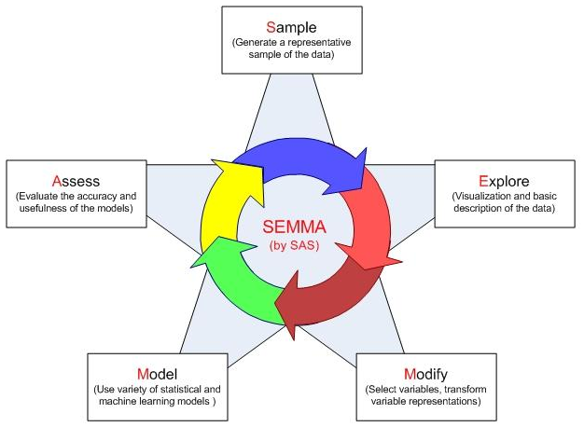
Data Mining Process – SEMMA
Sample
Explore
Modify
Model
Assess
Notes:
https://3.bp.blogspot.com/-5kZcCc3J3Ko/UhIqDpX7W1I/AAAAAAAACzA/bdh7uzErRHQ/s1600/SEMMA.JPG

Slide 18
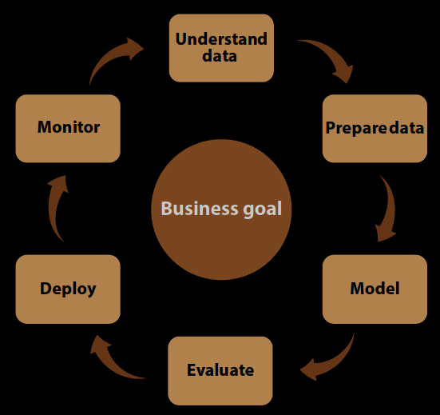
Predictive Analytics Process - Forrester Research (2013)
Continuous process to ensure effectiveness
Notes:
http://blogs.sas.com/content/sascom/files/2013/01/Crop.jpg

Slide 19
Knowledge Discovery Process
Data Understanding
Collect initial data
Describe the data
Explore the data
Verify data quality
Data Preparation
Data selection
Data cleaning
Data integration
Data transformation
Data reduction
Modelling
Select modelling technique
Generate test plan
Build the model
Test and Assess the model

Slide 20
Data Understanding

Slide 21
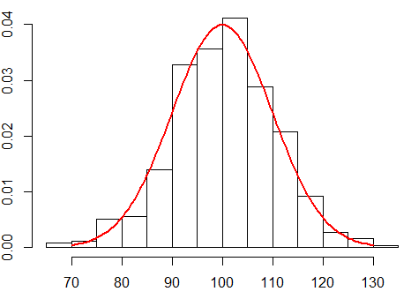
DATA UNDERSTANDING
Data objects and attribute types
Nominal, Binary, Ordinal, Numeric
Discrete or Continuous
Statistical descriptions
Central Tendency: Mean, Median, Mode
Dispersion of Data: Range, Quartiles, Variance, Standard Deviation, Interquartile range
Outliers
Notes:
“So what can we learn about our data that’s helpful in data processing”
Central tendency tell us if data are symmetric or skewed.
http://1.bp.blogspot.com/-khfUUIQHyPg/UO2iS9ZhrlI/AAAAAAAAAZc/-B-HLV06Ta0/s1600/Rplot.png

Slide 22
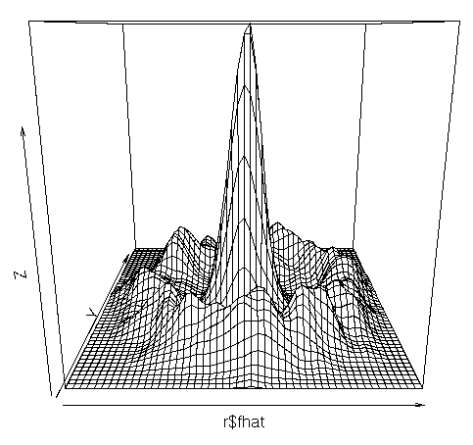
Data Exploration
Data Quality Assessment: missing values, inconsistencies, outliers etc.
Knowledge Discovery: patterns, trends, structure, similarity, relations etc.
Find ways to improve data set
Data Profiling: characterisation generalisation
Interpret the data, let the data speak for itself
Notes:
Data Matrix/Dissimilarity Matrix
Cosine similarity - between two vectors of an inner product space. Determines whether two vectors are pointing in roughly the same direction.
http://zoonek2.free.fr/UNIX/48_R/g551.png

Slide 23
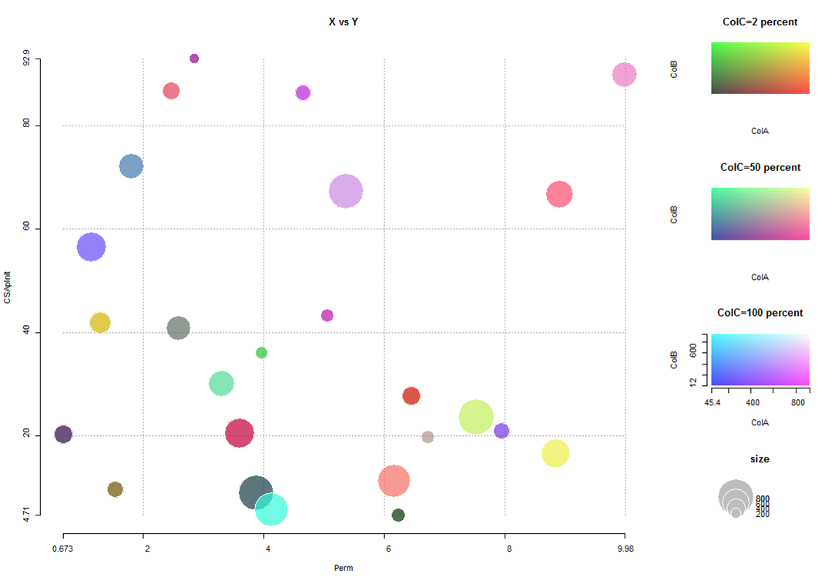
Data Visualisation
Used to find insights, make predictions and knowledge discovery:
Boxplots
Histograms
Scatter Plots
Correlation Coefficient
K-Nearest Neighbour
Chernoff faces
Pixelated graphs
Market Basket Analysis
Cluster Analysis
Link Analysis
Heat Maps
Decision Tree
Word Cloud
Etc…

Slide 24
Data Pre-Processing

Slide 25
DATA PREPARATION
Data cleaning - Fill in missing values by data imputation, smooth noisy data by binning, regression or clustering, identify or remove outliers, and resolve inconsistency
Data integration - Integration of multiple databases
Data transformation - Normalisation, aggregation, attribute/feature construction
Data reduction - Dimensionality reduction, feature selection, Principal Component Analysis, Factor Analysis, sampling

Slide 26

Data cleaning
Noise
Missing Data
Outliers
4 V’s of Big Data:
Veracity
Volume
Velocity
Variety
Data Understanding
Useful for processing
Visualisation
Smoothing
Filling missing values
Removing outliers
Resolving inconsistencies
ETL (Extraction-Transformation-Loading)
Notes:
Real world data are typically noisy, enormous in volume, and not uniform.
Veracity - Uncertainty of Data
Volume - Scale of Data
Velocity - Analysis of Streaming Data
Variety - Different forms of Data
http://www.air-worldwide.com/uploadedImages/Consulting/clean_up_data.gif

Slide 27
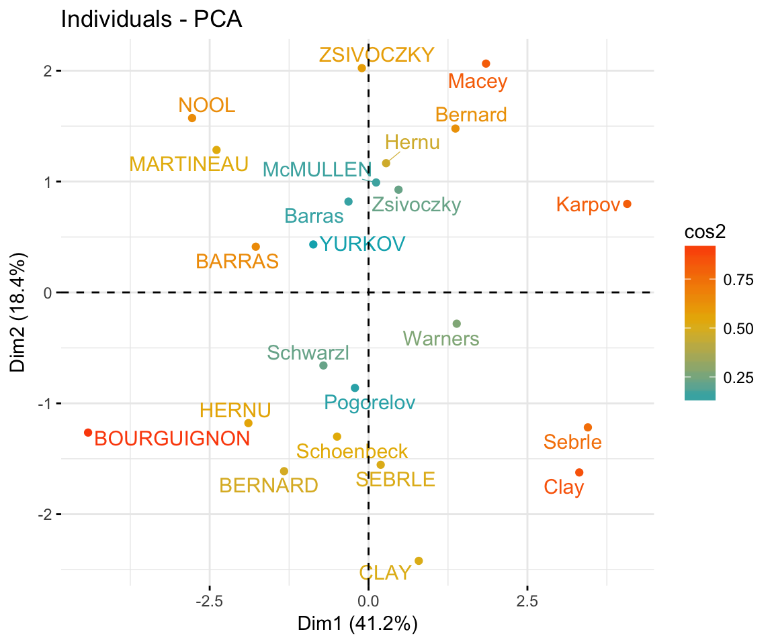
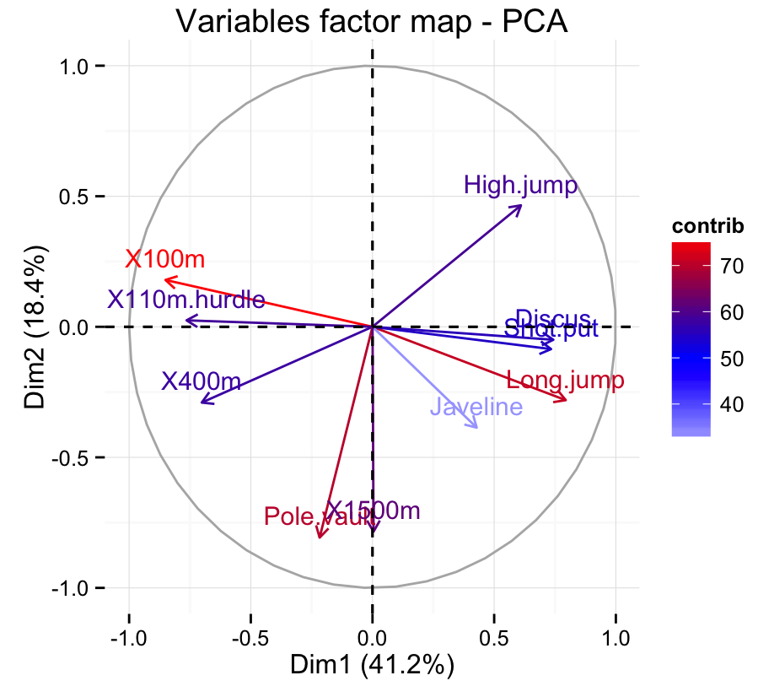
Principal component analysis
Data reduction
PCA combines the essence of attributes by creating an alternative, smaller set of variables
The Principal Components serve as new axes for the data.
Data size can be reduced by eliminating the weaker components.
Notes:
Individuals with a similar profile are grouped together.
http://www.sthda.com/english/articles/31-principal-component-methods-in-r-practical-guide/118-principal-component-analysis-in-r-prcomp-vs-princomp/
Graph of variables. Positive correlated variables point to the same side of the plot. Negative correlated variables point to opposite sides of the graph.
http://www.sthda.com/sthda/RDoc/figure/factor-analysis/principal-component-analysis-prcomp-variable-contribution-factoextra-data-mining-1.png

Slide 28
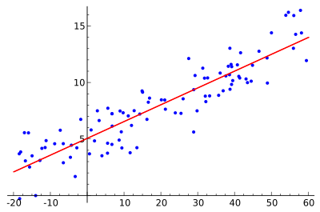
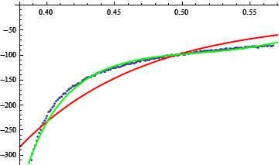
Regression & log-linear regression
Data reduction
Approximate given data
Linear regression often uses least-square method to minimise error
Multiple regression allows modelling of multidimensional space
Log-linear models approximate discrete multidimensional probability distributions
Notes:
https://upload.wikimedia.org/wikipedia/commons/thumb/3/3a/Linear_regression.svg/400px-Linear_regression.svg.png
https://i.stack.imgur.com/JNcSS.png

Slide 29
DATA preparation
Partition: select training and testing data set
- 2/3 of data for training, 1/3 data for testing
- 2/3 of data for training, 1/6 for testing, 1/6 for validation
Cross-validation:
- divide data set into k subsamples, using k-1 as training and one subset as test data with k-fold cross validation
Data Balancing:
- output ratio of 1:4 ~ 4:6

Slide 30
Data Modelling

Slide 31
Different analytics approaches:
Nearest Neighbour Methods
Principle Component Analysis
Multi-Dimensional Scaling
Sequence Mining
Neural Networks
Network Analysis
Cox Regression
Collaborative Filtering
C5.0
RFM Analysis
Text Mining
Pattern Matching
Link Analysis
Ensemble Methods
Segmentation
Boosting
Data Visualisation
Clustering
Bagging
K-Means
CHAID
Outlier Detection
Random Forests
Prediction Models

Slide 32
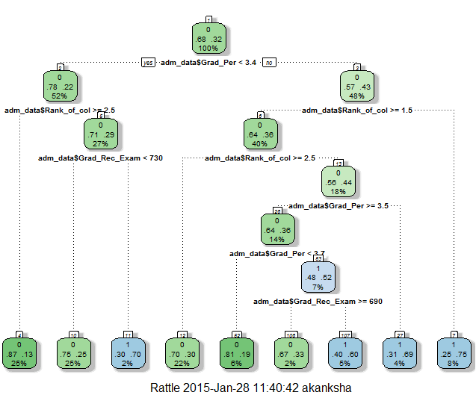
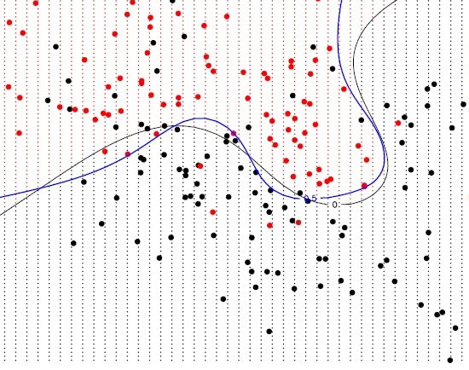
DATA MODELLING
Decision Tree
Random Forest
Adaptive Boost (Ada Boost)
Support Vector Machine (SVM)
Linear Regression
Neural Network
K-NN clustering
Etc…
Notes:
Select modelling technique > test plan > build model > test & assess

Slide 33
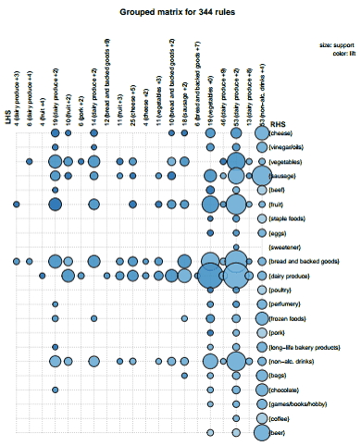
Market basket analysis
Patterns, associations and correlations
Frequent itemsets
Find strong association rules
Apriori Algorithm
Frequent itemsets by confined candidate generation
Uses prior knowledge
Reduce search space
Notes:
Anti-monoticity
https://datastudentblog.files.wordpress.com/2013/12/matrixbubble.png?w=788

Slide 34
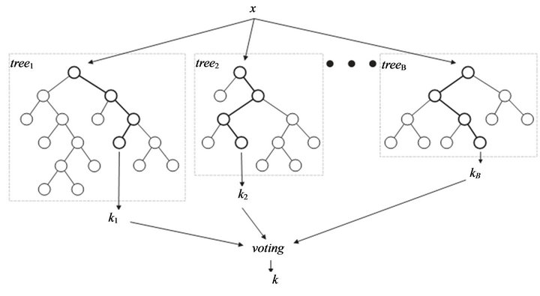
Decision tree
Classification
Learning of decision trees from class labeled training tuples.
Random Forests - Decision Trees
Individual tree generated using a random selection of attributes at each node
Each tree votes and the most popular class is returned during classification
Notes:
http://galvanize-wp.s3.amazonaws.com/wp-content/uploads/2015/11/04133123/random-forest.jpeg

Slide 35
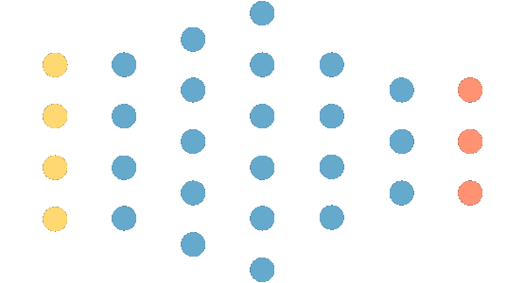
Neural network
Classification
Multilayer Backpropagation Feed-Forward
Input variables
Output classifiers
Hidden layers
Notes:
http://www.opennn.net/images/deep_neural_network.png

Slide 36
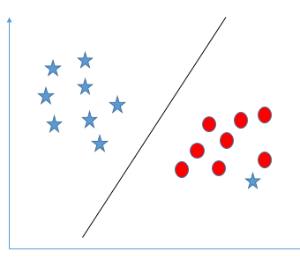
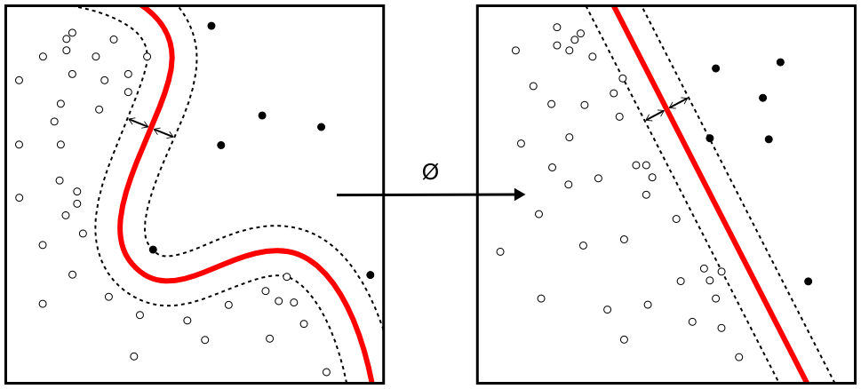
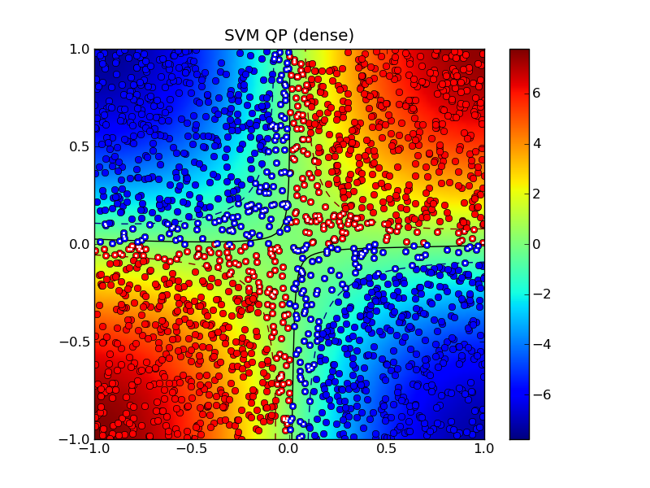
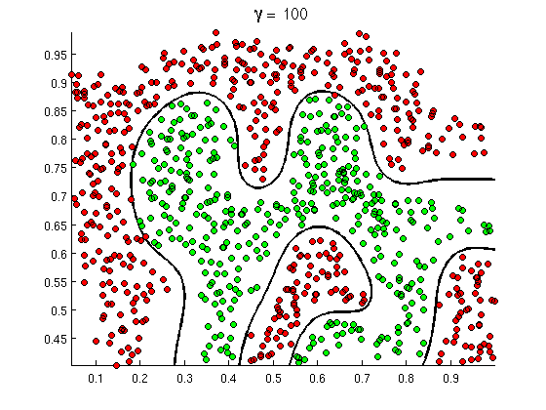
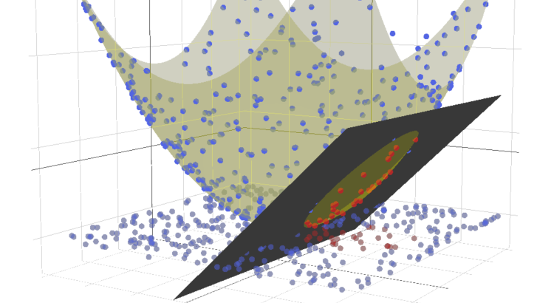
Support vector machines
Classification
Generate decision boundary using support vectors and margins.
Notes:
Non-linear transformation via kernel ∅:
Polynomial kernel :
Gaussian radial basis function kernel
Sigmoid kernel
https://www.analyticsvidhya.com/wp-content/uploads/2015/10/SVM_71.png
https://upload.wikimedia.org/wikipedia/commons/1/1b/Kernel_Machine.png
http://efavdb.com/wp-content/uploads/2015/05/svm_3d_cropped-750x410.png
https://qph.ec.quoracdn.net/main-qimg-44a86cdf39604dbcf24f9130470e774f
http://cvxopt.org/_images/xor_N2000_rbf.png

Slide 37
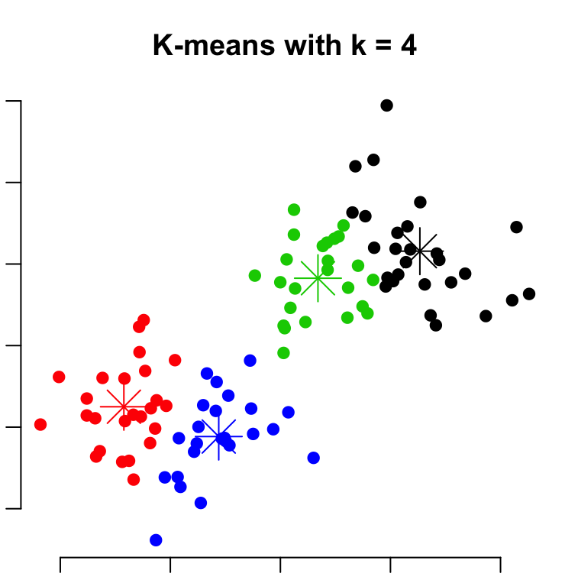
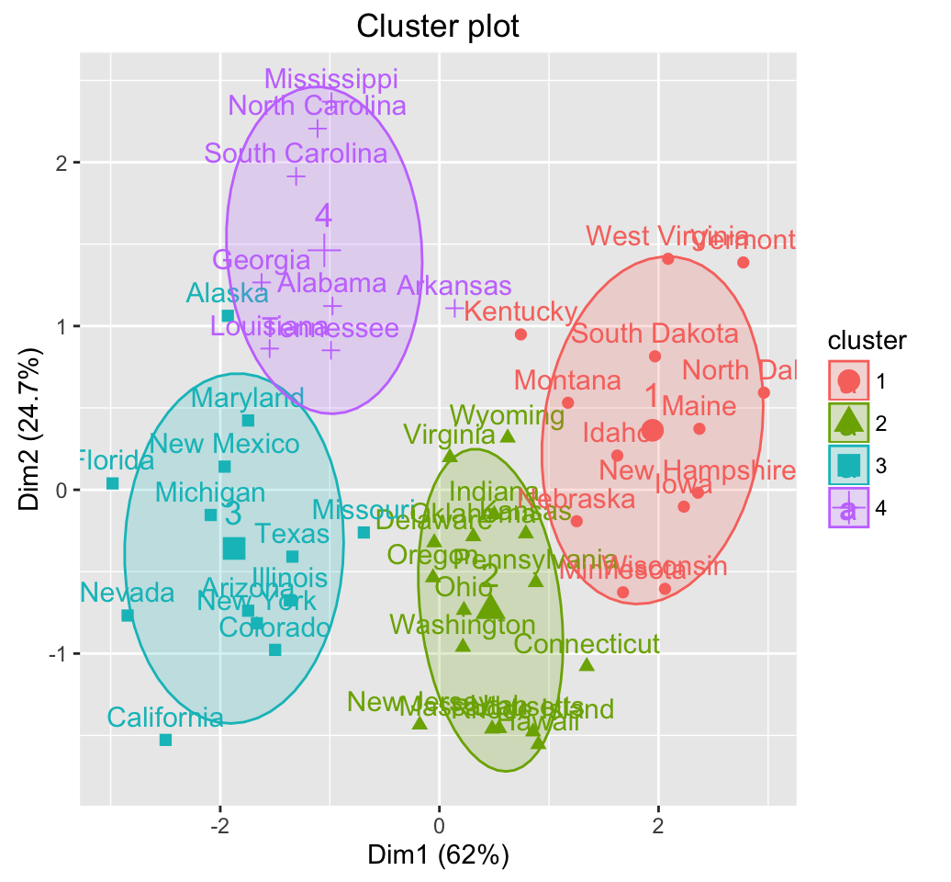
K-means
Cluster analysis
Partition by measuring distance and forming cluster variation
Each step repeated to improve within cluster variation.
Notes:
http://www.sthda.com/sthda/RDoc/figure/clustering/partitioning-cluster-analysis-k-means-plot-4-groups-1.png
http://www.sthda.com/sthda/RDoc/figure/clustering/hierarchical-k-means-clustering-k-means-clustering-1.png

Slide 38
Data Analysis (evaluation)

Slide 39
EVALUATION
Inspect model stability
Adjust model parameters and iterate
Try different modelling techniques
Improve data quality, new transformation, new/better data

Slide 40
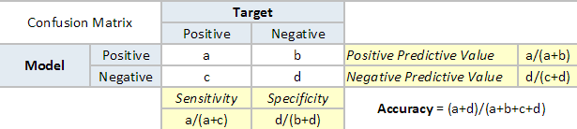
Confusion Matrix
Sensitivity (Recall) - True Positive rate
Specificity - True Negative rate
Precision - measure of exactness
Recall - measure of completeness
Notes:
Sensitivity is how well the model is able to predict positive correctly.
Specificity is how well the model is able to predict negative correctly, i.e. correctly reject.

Slide 41
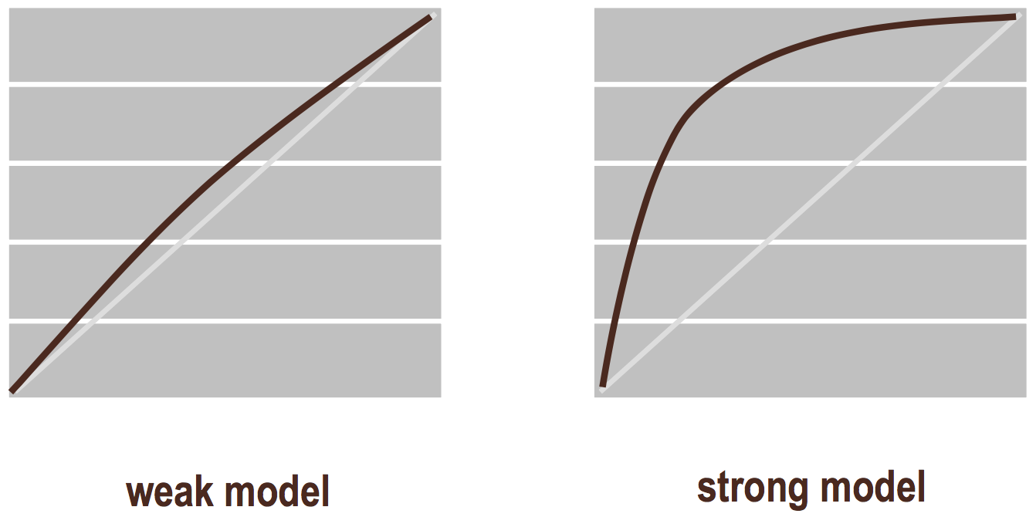
ROC - Receiver Operating Characteristic
Compare classification models
Compare sensitivity versus specificity across a range of values for the ability to predict a dichotomous outcome
Sensitivity, specificity, predictive values and likelihood ratios are all different ways of expressing test performance

Slide 42
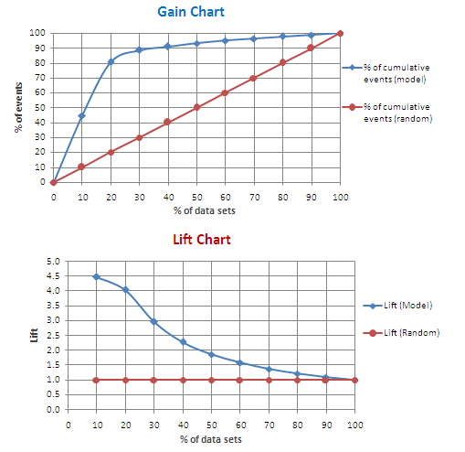
Gain Chart
Measure predictive model performance
Gain Chart: show the % of target reached against the population
Lift Chart: measure how much better one can expect to do with the predictive model comparing without a model
Notes:
http://1.bp.blogspot.com/-VkeOV1ANRR8/U--CSkv35oI/AAAAAAAADOQ/N-G_cKxoceE/s1600/Gain%2BLift%2BChart.PNG

Slide 43
Rattle
R Analytical Tool To Learn Easily - Data miner built on R

Slide 44
Why R ?
Free and Open source
Available in all platforms
Widely used, 2 million users, large community
Software environment for data analysis, statistical computing and graphical techniques
Originated from S, statistical programming language developed by John Chambers at Bell Labs in the 1970s
First version of R developed by Robert Gentleman and Ross Ihaka at the University of Auckland in the mid-1990s
Notes:
The best thing about R is that it was developed by statisticians. The worst thing about R is that… it was developed by statisticians. — Bo Cowgill, Google, Inc.

Slide 45
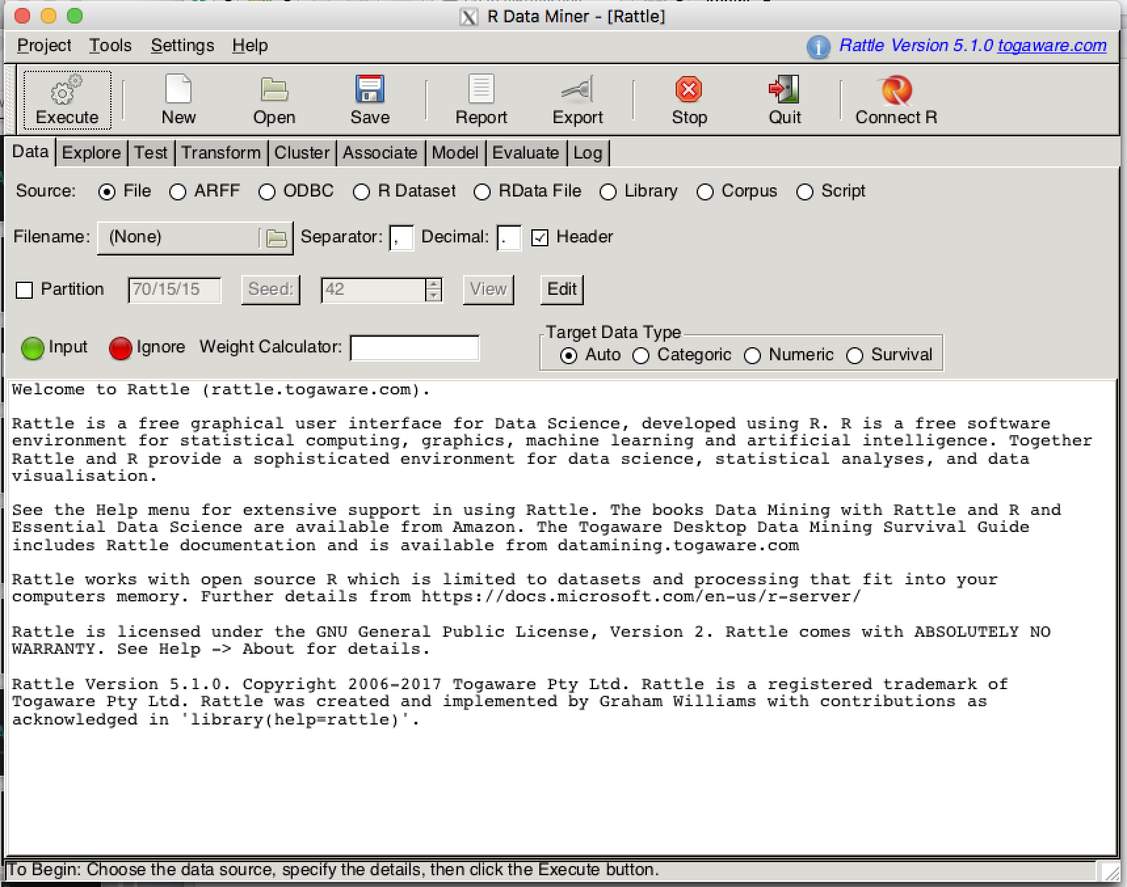
( R Analytical Tool To Learn Easily )
Rattle
>library(rattle)
>rattle()

Slide 46
TRY, EXPLORE, PRACTICE …
Thank you 😊
yuelin@womenwhocode.com
Notes:
The only way to learn.

Slide 47
Coming soon ...
Our next event:
Data Visualisation in R
Weekly session:
Social Coding Monday

